Slide 1
Radius Studio Rules using Rulespeak
Proposition

Slide 2
The customer says:
Hydrants must be digitised on the end of water pipes
Rulespeak says:
Rule: Hydrants must sit on the end of water pipes
Fact: Hydrants are any features from the hydrants table
Fact: Water pipes are any features from the distribution_pipe or mains_pipe table where in_service=true
Fact: ‘sit on the end of X’ means ‘geometry intersects ends_of(X.geometry)’

Slide 3
The customer says:
Hydrants must be digitised on the end of water pipes
Radius Studio rule says:
Rule for Hydrants
Check that there exists at least one feature water_pipe
Where hydrants.geometry intersects water_pipe.geometry
AND class(water_pipe) =‘mains_pipe’ OR
class(water_pipe) =‘distribution_pipe’
AND water_pipe.in_service=‘TRUE’
AND hydrants.geometry intersects ends_of(water_pipe.geometry)

Slide 4
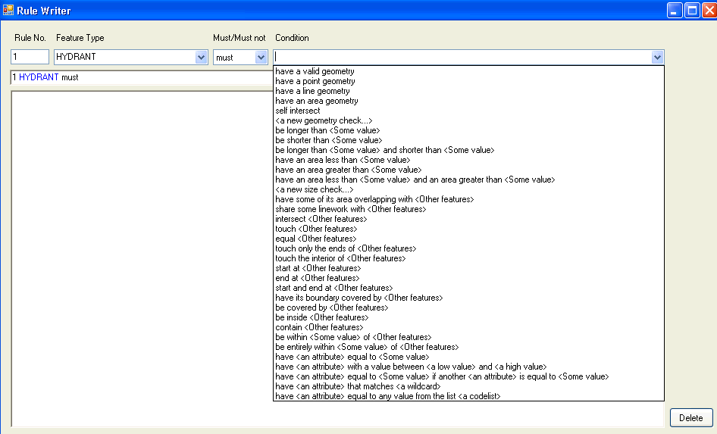
A possible rulespeak user interface for the most common Radius Studio rules:
A rule is made up of: <featuretype> must or must not
<some condition possibly related to other features>
The rulespeak appears here, could allow users to type directly using autocomplete

Slide 5
A list of common conditions to check, but users can define their own, which is like a ‘fact’ in rulespeak

Slide 6
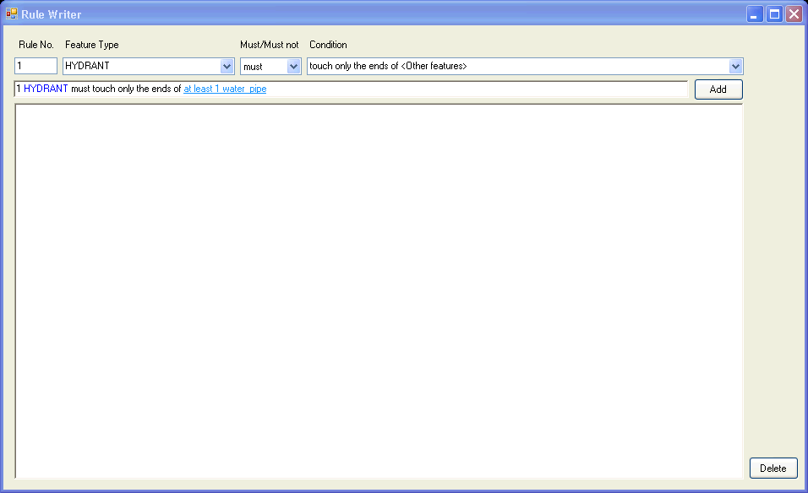
Here, the user has typed water pipe into the combo box. It is not one of the featuretypes in the schema so it is a hyperlink which means it needs to be defined

Slide 7
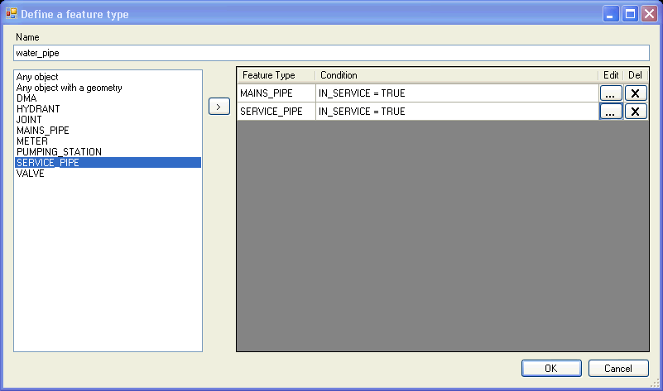
Clicking on he hyperlink lets you define what a water pipe is. Here we say it is the features from 2 existing feature types but only those that are ‘in service’

Slide 8
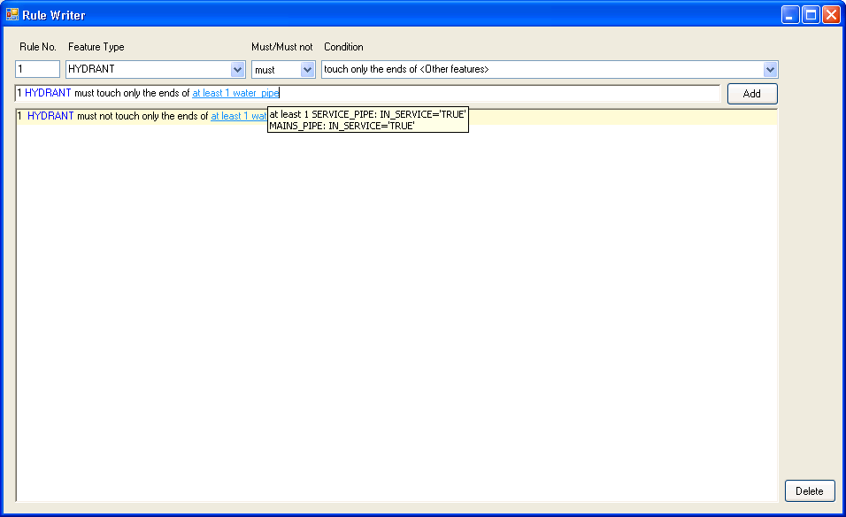
Now we have the definition of a rule. A tooltip on user-defined parts tells us what the user-defined ‘fact’ is.

Slide 9
User-defined conditions
As well as using facts to define abstract feature types, we also define new conditions to help the rule writers use their own vocabulary, e.g.:
‘A Discharges into B’ means ‘end_of(A.geometry) intersects B.geometry’
Now a rule can be created in the form:
Sewer pipe must discharge into a foul water feature
And the user has told us the definitions (facts) for
Sewer pipe
Foul water feature
Discharge into
Each of these rules can now be exported as executable Radius Studio rules.

Slide 10
Issues and opportunities
You cannot create all possible rules using the simple interface – would need to be able to define new ‘templates’ that can be dropped and extend the types of rules allowed
Round tripping – would not be able to reverse engineer existing Studio rules, or be able to feedback changes if the exported Studio version of the rule is changed.
Makes it easier to ship sets of rules in which the facts are not yet defined and the user tells you how they map to their schema, i.e. ‘tell us how your schema stores “active water pipes”’

